Slide 1
Mr. Gonzalo Gabriel Carranza gonzalo.carranza@uam.es
Transitional Constitutionalism:
Context and Perspectives
Asymmetries in South America's Federalism:
the Argentinian Case after the 1994 Constitution

Slide 2
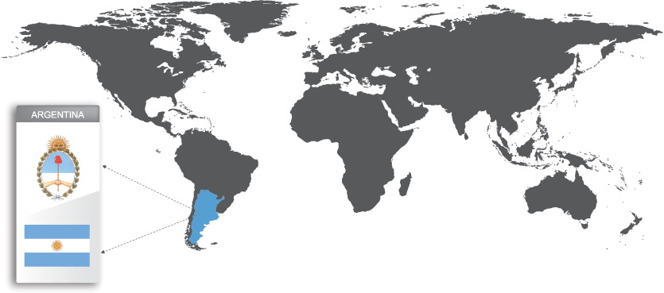
Argentina in the world

Slide 3
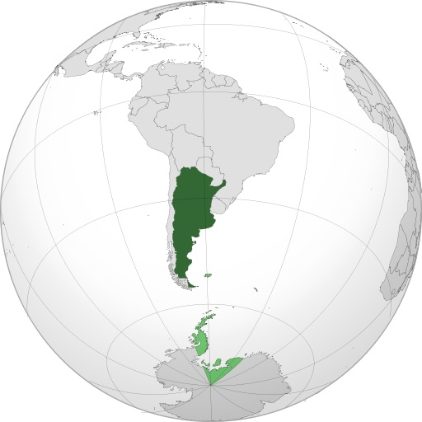
Argentina in South America

Slide 4
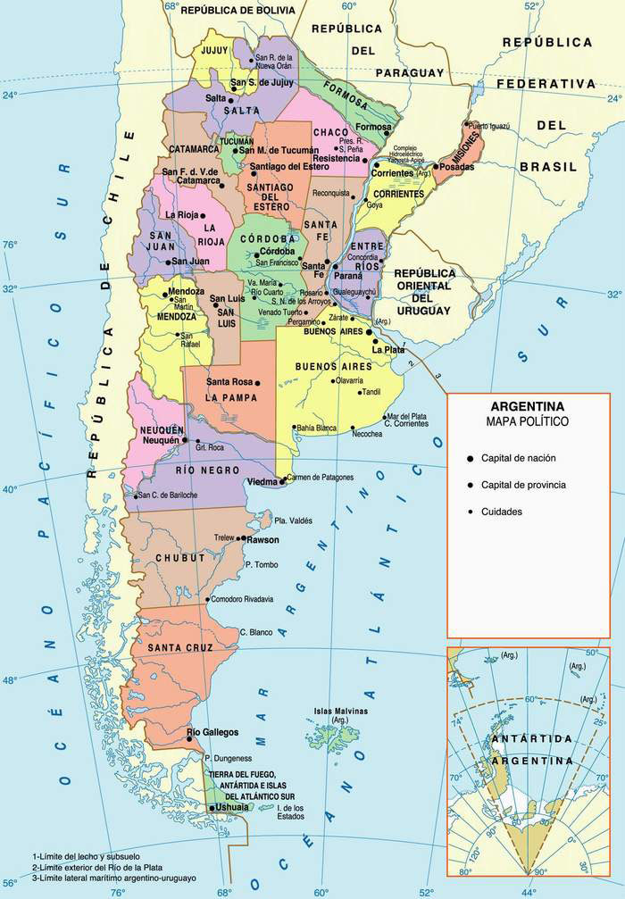
Political unit

Slide 5
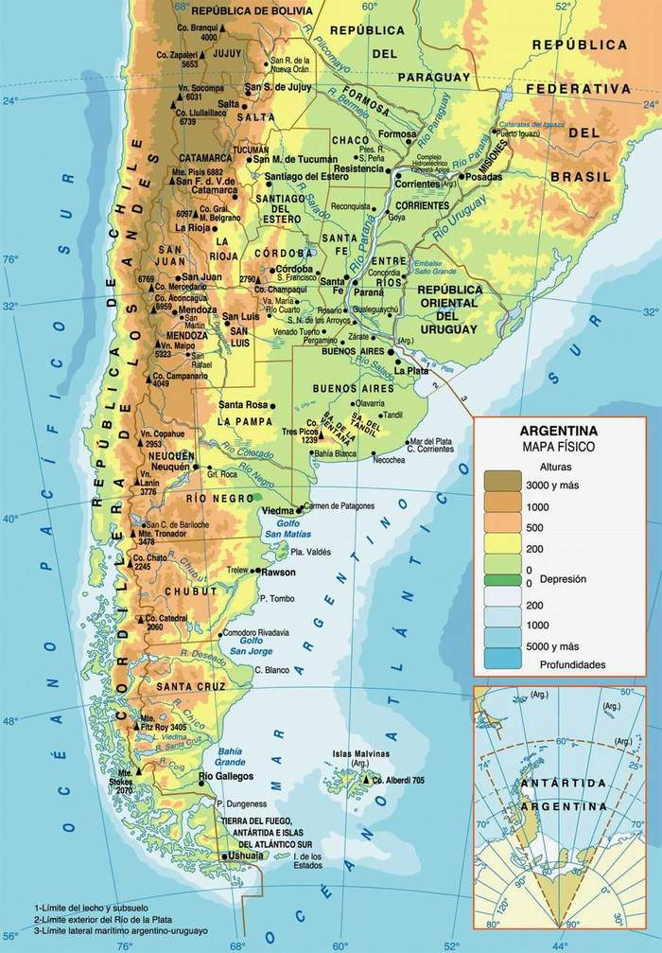
Physical map

Slide 6
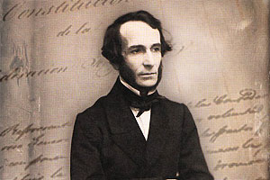
Juan Bautista Alberdi,
father of the Constitution

Slide 7
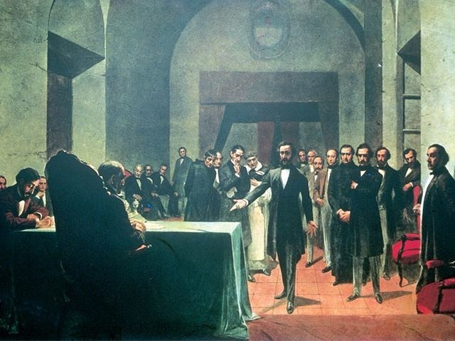
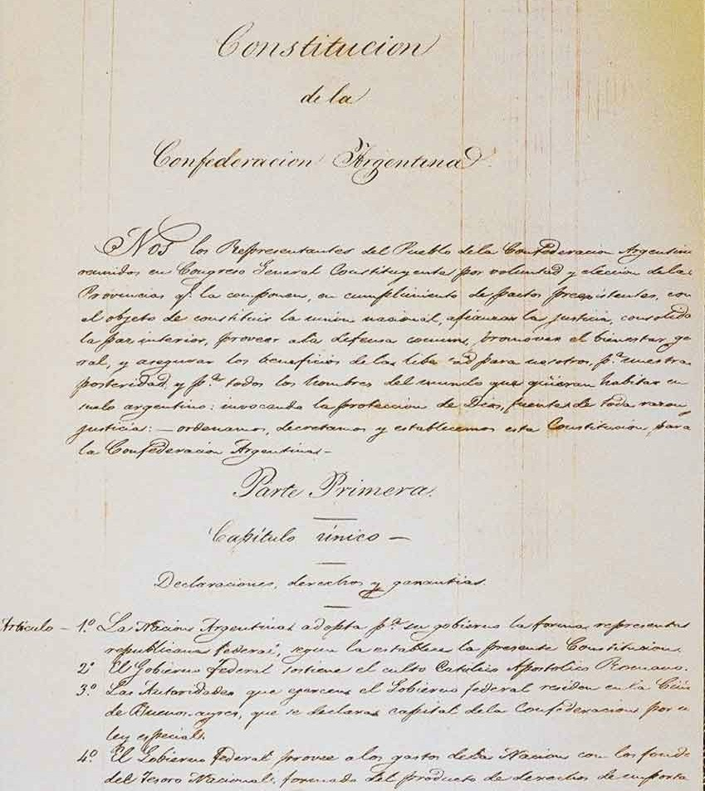
Oath to support the Constitution (1853)

Slide 8
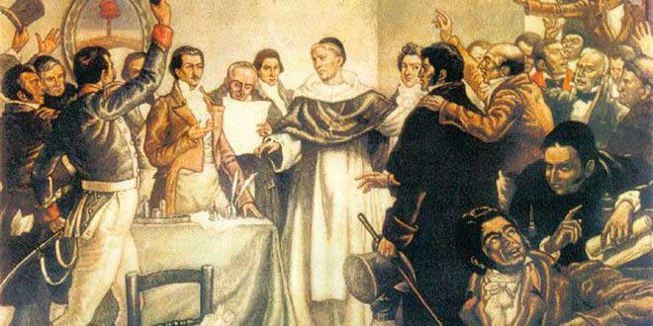
Independence Day (9 July, 1816)

Slide 10
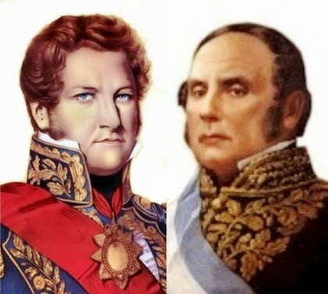
Juan Manuel de Rosas
Governor of Buenos Aires
Justo José de Urquiza
Governor of Entre Rios

Slide 11
Olivo’s Agreement
(Pacto de Olivos)

Slide 12
Latent problems in Argentina’s federal system
Regional Asymmetries
Political Asymmetries
Fiscal Asymmetries
Legal Asymmetries

Slide 13
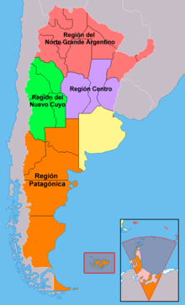
Regional Asymmetries

Slide 14
Political Asymmetries
Federals vs. Unitary

Slide 15
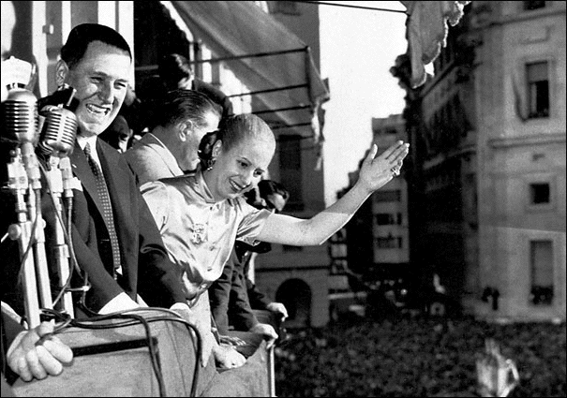
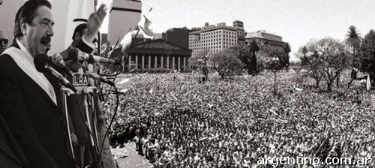
Radicales
Peronistas

Slide 16
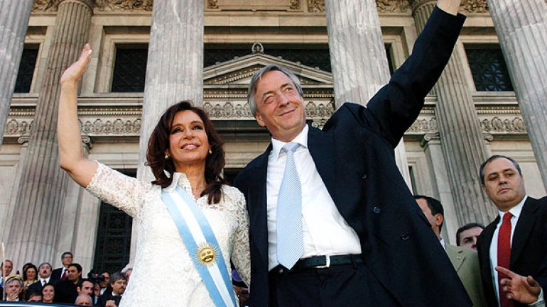
Mauricio Macri
Néstor and Cristina
Kirchner

Slide 17
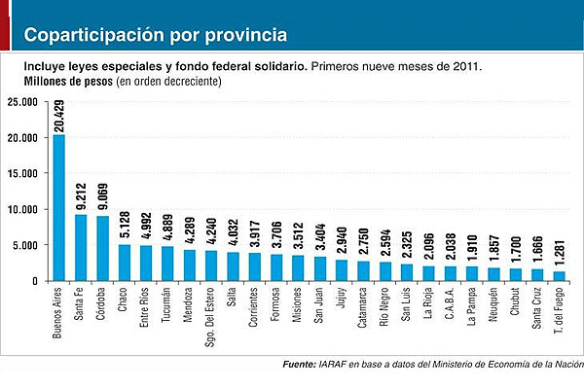
Fiscal Asymmetries
Federal tax revenue sharing law

Slide 18
Legal Asymmetries
Subordination
Participation
Coordination
FEDERAL LOYALTY
(Bundestreue)

Slide 19
Challenges of Argentinian’s federal system
Reduction of political and regional asymmetries
Intergubernamental relationships
Fiscal Balances

Slide 20
“One for all and all for one”
THANK YOU!

